Slide 1
MPMCI Online Class
On 16-4-2020
to IV Sem CSE-A
B.Syamala
Asst.Professor
CSE,VCE

Slide 2
Programmable DMA Controller
The bulk data transfer from fast I/O devices to the memory or from the memory to I/O devices through the accumulator is a time consuming process
For such a situation the direct memory access(DMA) technique is preferred
In DMA data transfer scheme, data are directly transferred from an I/O device to RAM or from RAM to an I/O device
The Intel 8257 is a Programmable DMA Controller
It is a 4-Channel Programmable Direct Memory Access Controller
It is a 40 pin I.C Package and requires a single +5v supply for its operation
4 I/O devices can be interfaced to the MP through this device
It is capable of performing 3 operations namely Read, Write and Verify

Slide 3
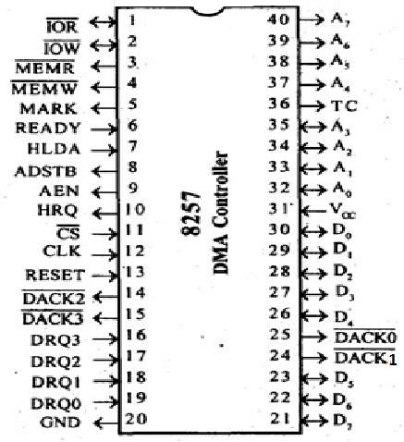
Pin Configuration

Slide 4
Operation…
During the read operation data are directly transferred from the memory to the I/O device
During the write operation data are transferred from the I/O device to the memory
On receiving a request from an I/O device, the 8257 generates a sequential memory address which allows the I/O device to read or write directly to or from the memory
Each channel incorporates two 16-bit registers, namely
(i) DMA address register
(ii) Byte count register
These registers are initialized before a channel is enabled
Initially the DMA address register is loaded with the address of the first memory location to be accessed.

Slide 5
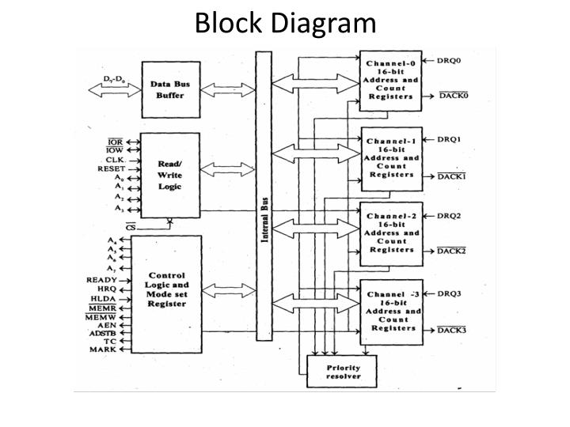
Intel 8257 Programmable DMA Controller
8257

Slide 6
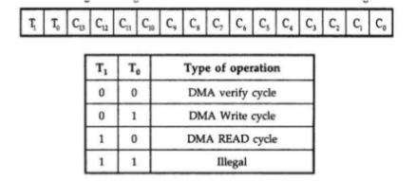
Operation…
14-Lsb bits of the byte count register store the number of bytes to be transferred
2-Msb bits of the byte count register indicate the operation which will be performed by the controller on that channel
The 8257 also includes a mode set register and a status register
Pin Description
DRQ0-DRQ3 these are DMA request lines. An I/O device sends its DMA request on one of these lines. A High status of the line generates a DMA request
DACK0-DACK3 these are DMA acknowledge lines
A0-A7 these are address lines

Slide 7
Operation…
D0-D7 are data lines
AEN Address latch enable
ADSTB is used to split the data and address line from the DMA
CS it is chip select
I/O Read and I/O Write ( IOR and IOW ) : These are active low bi-directional signals.
Memory Read and Memory Write ( MEMR, MEMW) : These are active low signals.
TC (Byte Count) Terminal count
CLK Clock
HRQ Hold request
HLDA Hold Acknowledge

Slide 8
Operation…
An I/O device sends its request for DMA transfer through one of the four DRQ lines.
On receiving the DMA request for DMA data transfer from an I/O device, the intel 8257 sends the hold request to the CPU through the HRQ line
After receiving the hold acknowledge from the CPU, it sends DMA acknowledge to the I/O device through DACK line.
The memory address is set out an address and data lines

Slide 9
Operation…
For DMA read cycle, in which data are transferred from memory to I/O devices, two control signals MEMR and I/OW low activated signals are issued by 8257
i. The MEMR enables the addressed memory for reading data from it
ii. The I/OW enables the I/O device to accept data
Similarly for DMA write cycle, in which data are transferred from the I/O device to the memory, two control signals MEMW and I/OR are issued by the controller
i. The MEMW enables the addressed memory for writing data to it
ii. The I/OR enables the I/O device to output data
The byte count is decremented by one, after the transfer of one byte of data
When byte count becomes Zero, TC goes high indicating that the data transfer using DMA is complete

Slide 10
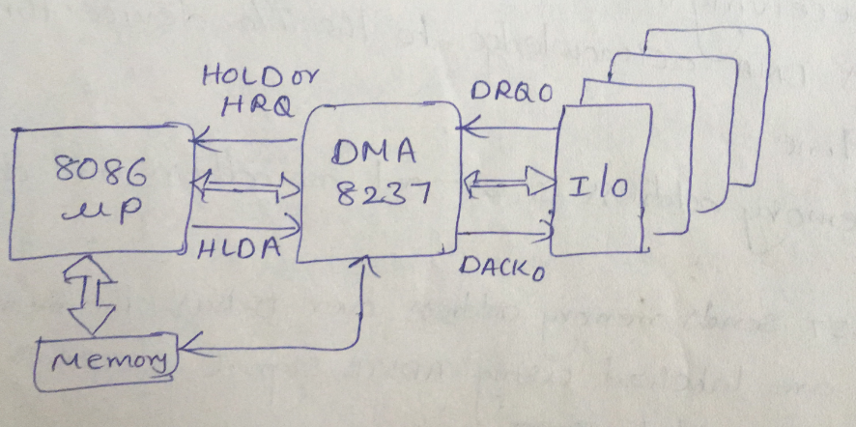
DMA interfacing with 8086 Microprocessor

Slide 11
Thank you

